Slide 1
Elements of Risk Assessment and Risk Profiles
Unit 3A
Risk Analysis in Safety Engineering
Fall 2022

Slide 2
References
Modarres, M., Risk Analysis in Engineering, Taylor & Francis, 2006, Chapter 2 (Modarres, RAE)
Norman Fenton and Martin Neil, “Risk Assessment and Decision Analysis with Bayesian Networks, 2nd ed.” CRC Press, 2019 (RDBN, 2019)
Pasman, Hans J., Risk Analysis and Control for Industrial Processes-Gas, Oil and Chemicals: A System Perspective for Assessing and Avoiding Low-Probability, High-Consequence Events, Elsevier, 2015
Modarres, M., M. Kaminskiy, V. Krivtsov, Reliability Engineering and Risk Analysis, 2nd ed, Taylor & Francis, 2010, Chapter 1 (Modarres, RERA)
Jordaan, Ian, Decisions Under Uncertainty– Probabilistic Analysis for Engineering Decisions, Cambridge University Press, 2005 (Jordaan, 2005)
Ayyub, B.M., Risk Analysis in Engineering and Economics, Chapman & Hall/CRC, 2003 (Ayyub, RAEE)
Kumamoto, H., Satisfying Safety Goals by Probabilistic Risk Assessment, Springer, 2007 (Kumamoto, 2007)
Judea Pearl, The Book of Why, Basic Books, New York, 2018 (Pearl, 2018)

Slide 3
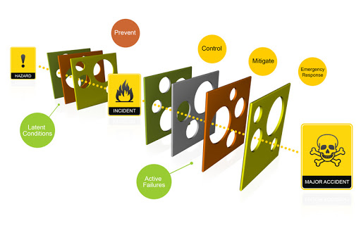
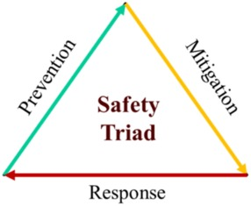
Safety Triad: Prevent, Mitigate, Respond
Preventive measures to reduce chance of an unwanted event
Mitigative measures to stop the propagation of the unwanted event
Response measures or emergency management system in place to reduce the consequences
Monitor, measure and update each measure

Slide 4
Risk Quantification
Risk depends on:
Scenario, S, Probability, P, and Consequences, C.
Risk vector: (P,C), can be used for ranges of risk averseness, C^{β}, where β is Risk Averseness parameter for prioritization.
β < 1 (risk seeking), β = 1 (risk neutral), β >1 (risk averse),
scenarios
Risk Neutral Expression (β = 1): ${R=P}_{i}.C_{i} ;with S_{i}=1,2,…n$

Slide 5
Review
Point value probability of specific event E is based on relative frequency of occurrence with each n assumed equally probable:
This point value estimate method is more accurate for more data with larger n and N.
This expression is based on the classical or frequentist definition of probability from the observed event occurrence frequency.
Values of probability and consequences can be
Discrete (points values, or uniform values over intervals) OR
Continuous (distributions)

Slide 6
Neutral Risk Level Calculation, β=1
Needed: Hazard-based Scenario, Probability (or Frequency), Consequences
Scenario: US yearly auto driving fatalities
Frequency: 15x10⁶ auto accidents/year
Consequence: 1 fatality/300 accidents
Risk of fatality Frequency Consequence

Slide 7
Risk Neutral, β=1, Illness Examples
Health hazards caused by Salmonella
Illness frequency: 893,000 per year
Cost per illness = $400
Death magnitude: 710 deaths per million illnesses
Mortality risk, point value, = (Frequency) x (Consequence) =634 deaths/year
Economic risk, point value, = (Frequency) x (Consequence)
= $ 357 x 10⁶/year
893,000/yr
710 deaths/ 1,000,000
893,000/yr
$400

Slide 8
Automobile Incidents Example: Multiple Outcomes
Data from US Dept. of Transportation 2013:
6.3 million automobile incidents in 2013
U.S. population exposed to autos = 250 million
1 in 3 caused injury, 1 in 165 caused death
Average loss: $450,000/death (willingness to pay for a life is not included) and $15,000/injury
Property damage loss: $25,000 if involving fatality and $10,000 if involving injury, $3,000 for all other incidents
Calculate the monetary risk of auto incidents/driver.
Begin by calculating P(incident/person) = n/N
= 6.3/250 = 0.025.

Slide 9
A Monetary Metric for Auto Risk
Risk Contributor | Fatality related | Injury related | Other
P(incident) = # incidents/# person = n/N | P(incident)/person = 0.025 | P(incident)/person = 0.025 | P(incident)/person = 0.025
P(consequence | incident) | P(fatality|incident) = 1/165 | P(injury|incident) =1/3 | P(other|incident)
Pr of consequence per person = P(con|inc)P(inc) | ^{0.025×1/165} | ^{0.025×1/3}
Magnitude of consequence, $ | C_{F} | C_{I} | C_{O}
Risk (loss/driver), $ | R_{F} | R_{I} | R_{O}
= $450,000
Monetary Risk (fatality, injury, other) = R_{F} + R_{I} + R_{O}=

Slide 10
Risk Calculation Review
Risk level (neutral, β = 1) for scenario outcome, S_{i}:
R = sum of consequences with each weighted by the Pr of occurrence
Total risk point value and distribution for several components or scenarios, discrete or continuous distributions:
Risk of driving includes the risk of the 3 scenarios of injury, property damage (fatality, injury, other), fatality.
discrete
continuous

Slide 11
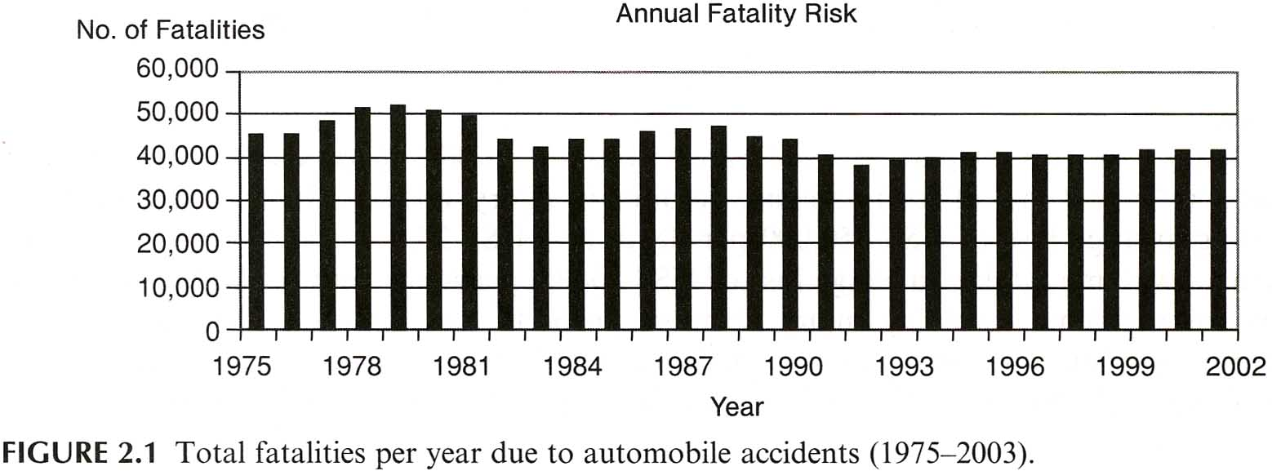
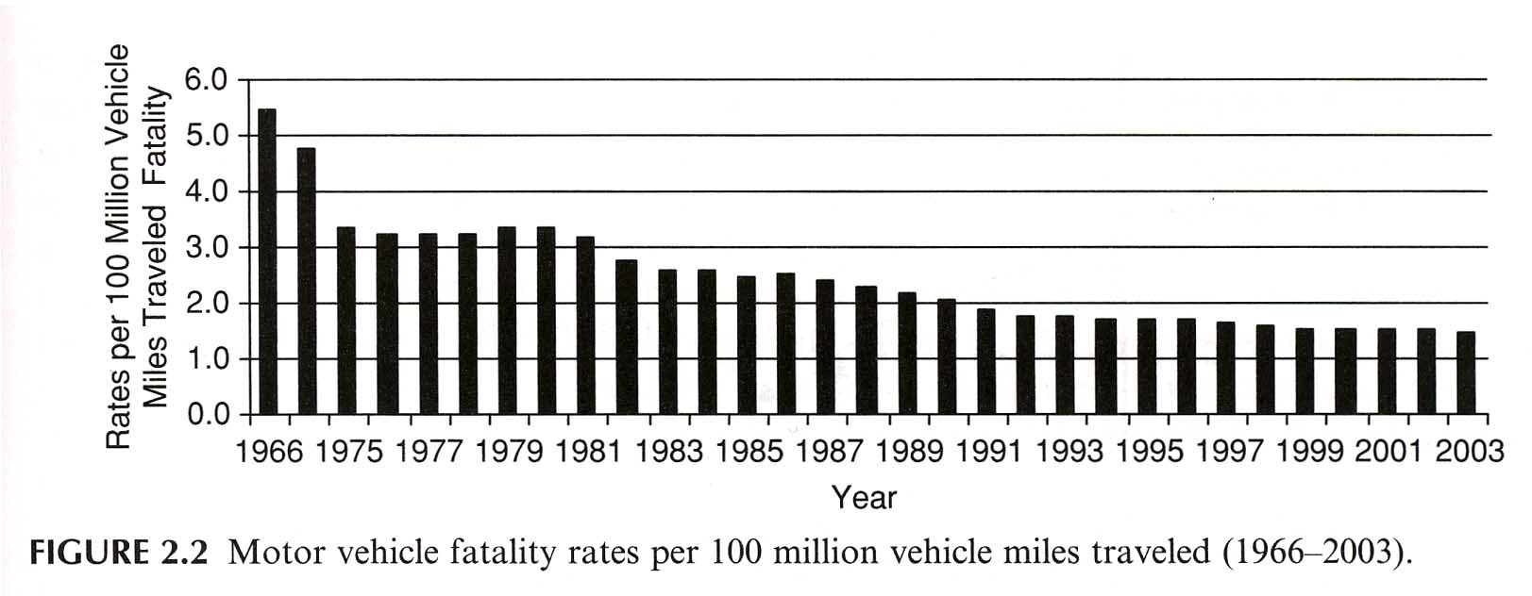
Risk in different units to identify contributors to the risk
Automobile fatality over 27 years:
Risk ~ stable.
Normalized Automobile Fatality:
Risk over distance is reduced.
Causes: # cars, better roads, safer cars, trained drivers
(Modarres RAE)

Slide 12
Risk Profiles for a Graphical View
A Risk Profile is a plot of risk variables, such as probabilities or frequencies along Y axis and consequence severities along X axis. Other variables are also used.
Risk profiles are built to understand the spectrum of event frequencies (along Y) against consequences (along X). The goal is to identify the range over which the Risk is acceptable or tolerable.
F-N curves, Risk matrices, risk maps are widely used risk profiles

Slide 13
Single and Cumulative Risk Profiles
A Farmer risk profile is a plot of cumulative occurrence probability, P (or cumulative frequency, F), along Y and consequence severity along X.
If consequences are fatalities, the Y axis is cumulative frequency (or cumulative probability) of fatalities, F, and X is number of fatalities, N, resulting in a F-N curve.
F.B. Farmer suggested analysis of a spectrum of events to include:
High consequence events of low probability
Events of less consequence but more probable
He suggested a near-inverse relation of frequency, f, and consequence, c, as a criterion for risk acceptability: f ~ 1/c. So if c increases by a factor of 2, f must decrease by 1/2.

Slide 14
Cumulative Risk Profile Example: F-N curve
Plot shows the cumulative probability or frequency to exceed a target consequence level c.
The cumulative F at consequence c is the sum of all frequencies of events for which C ≥ c.
Cumulative
Different data will show curves of different shapes, but the cumulative P or F must decrease monotonically as C increases.
Probability/
Frequency
F’(C ≥ c)
Consequence c
Usually shown in saw-tooth style with Confidence Limits (dashed lines) to highlight uncertainty. This provides more support for realistic risk-informed decisions.

Slide 15
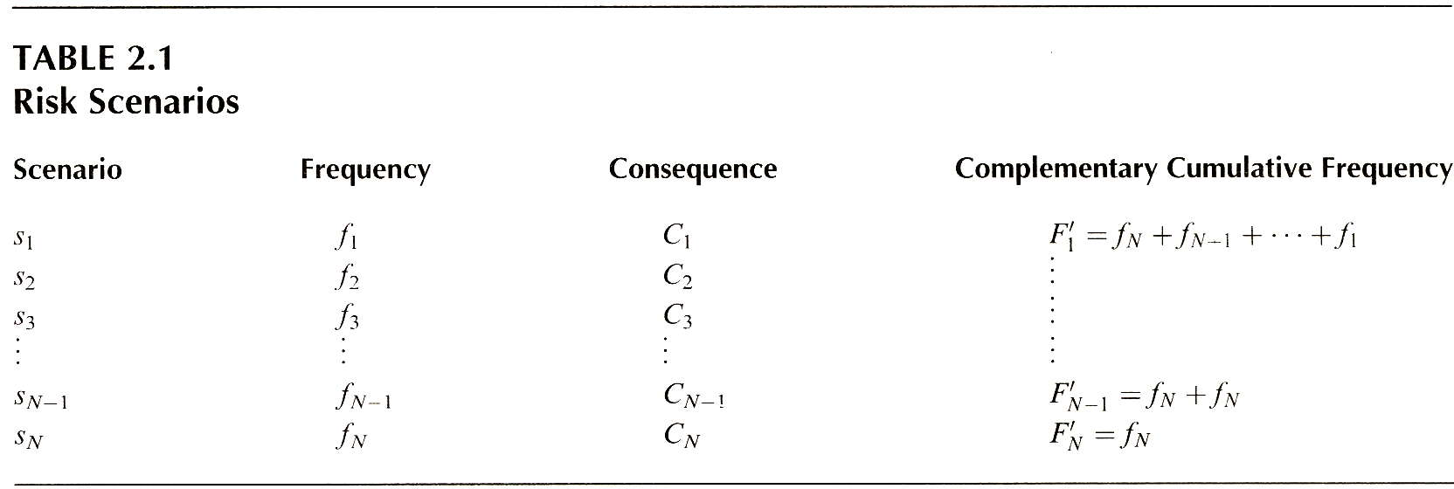
Cumulative F-N Risk Profile Discrete Data
(corrected)
Plot on X axis
Plot on Y axis
decrease
increase
decrease
all
–1
last
Note calculation method of cumulative (or excess) frequency, F’_{i} , for C ≥ C_{i} to obtain the sum of event frequencies with C ≥ C_{i}
(Modarres RAE)

Slide 16
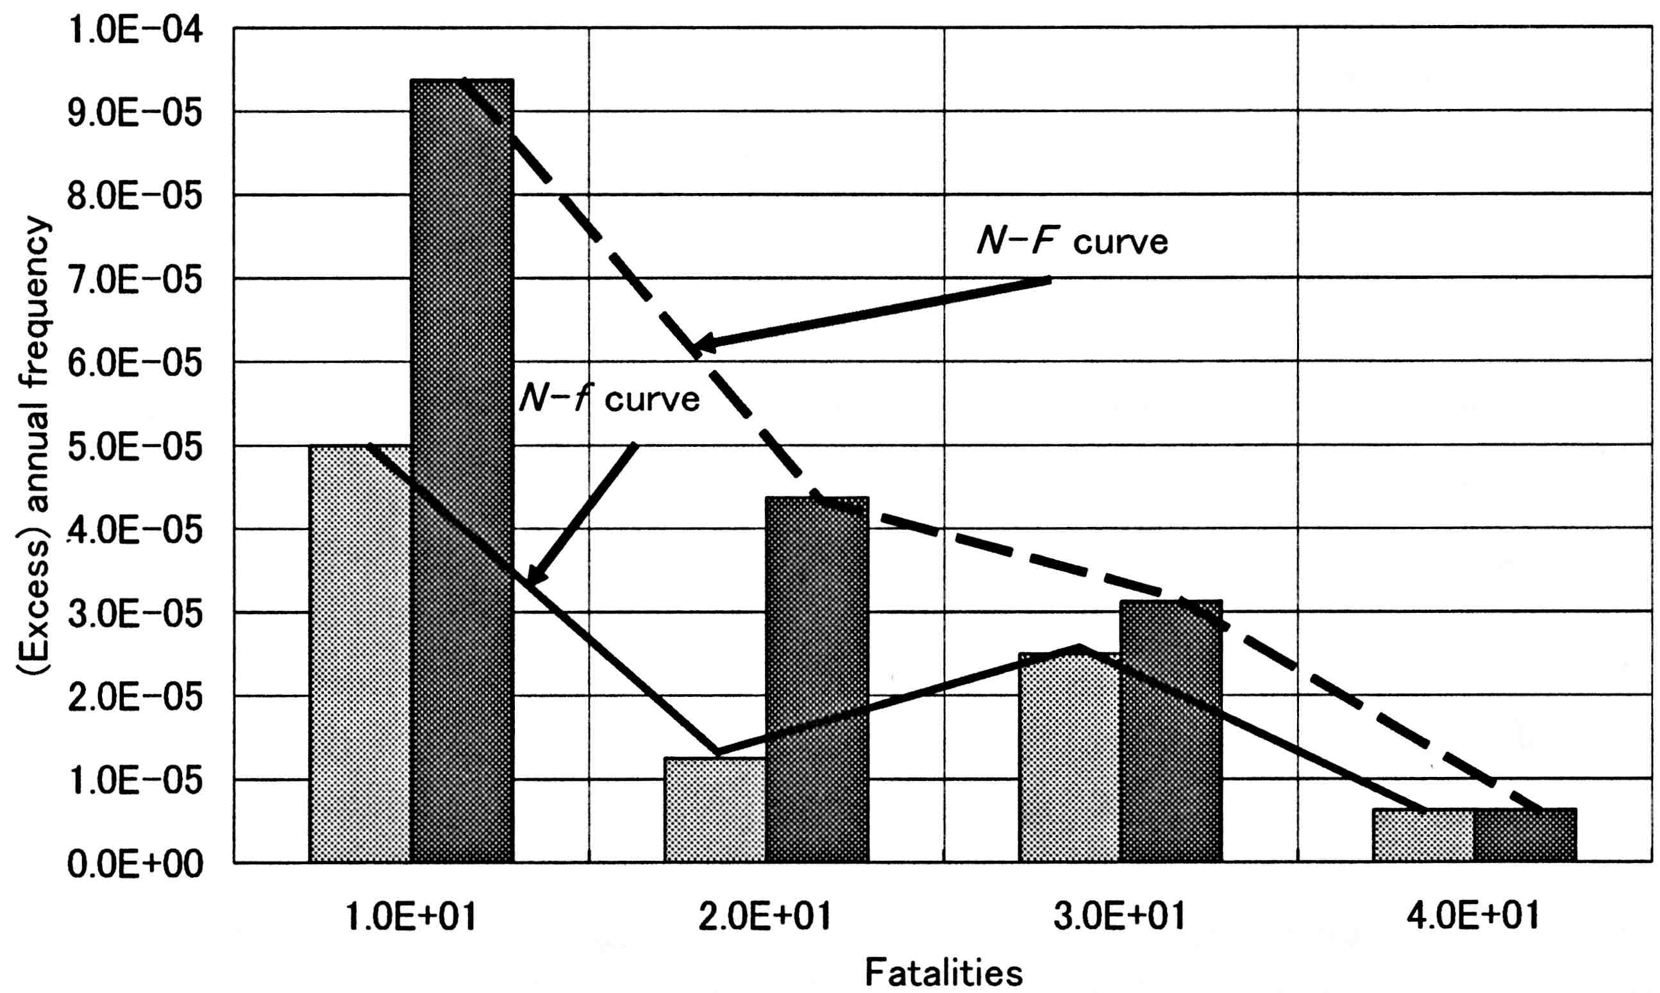
Cumulative F-N (dark-gray) Compared to Single f-N (light-gray) Risk Profiles
F = Σ_{i} f_{i}
f₁
Slope change due to increase in f from f₂ to f₃
f₃
f₂
f₄
F is cumulative frequency of events with fatalities ≥ n_{i} and f_{i} is the annual frequency of fatalities
(Kumamoto, 2007)

Slide 17
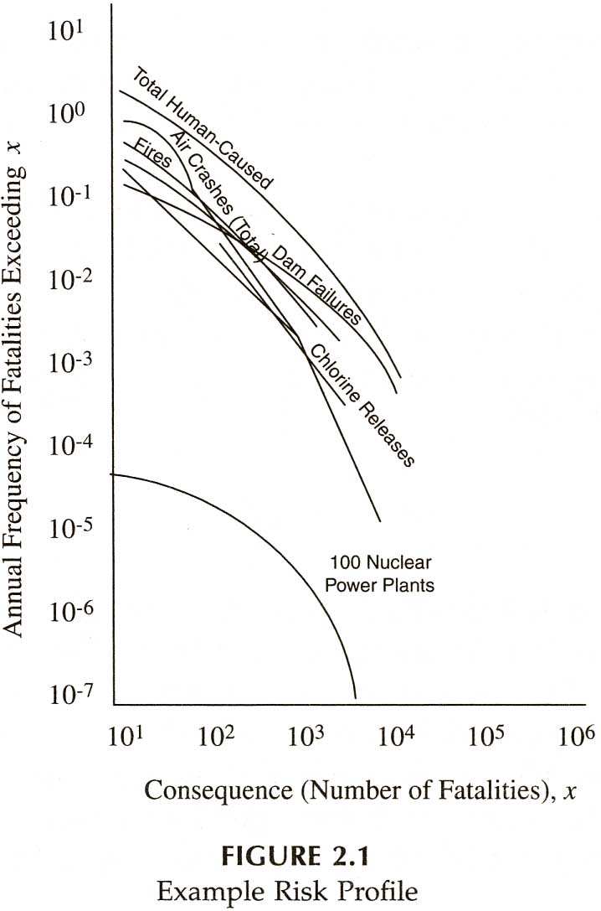
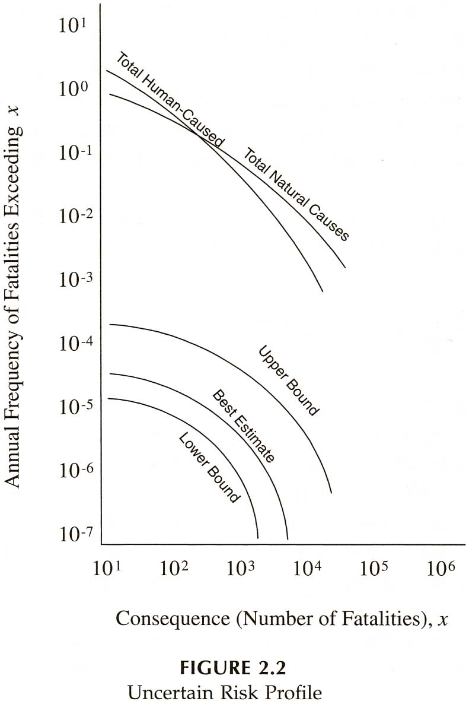
Cumulative Risk Profiles: F-N curves
A variety of curve shapes, but all are monotonically decreasing with X
mean with
upper and
lower 5%
confidence
limits
preferred
(Ayyub, RAEE)

Slide 18
Cumulative F-N Risk Profile Requirements
For the observed data different profile shapes will be observed.
The main questions to be answered by a cumulative F-N profile:
1. What is the cumulative frequency or probability of outcome events with consequence levels equal to and greater than a given threshold value, c, to be reduced in probability of occurrence?
2. Does the cumulative occurrence frequency or probability decline at an acceptable rate, as the consequence level, C, increases from one fatality to multiple fatalities?
For a risk averse manager, the greater the risk averseness, the more rapidly the frequency of occurrence must drop as the consequence level increases.

Slide 19
Another Risk Profile: Risk Matrices
A risk matrix is a representation of scenario outcome risk values in two dimensions with probability of occurrence along Y (or X) and consequence magnitudes or severities along X (or Y).
Probability and consequence data from plant records, from the literature, and by risk assessment are used to construct risk matrices.
Risk matrices traditionally are based on only point values or estimates of each scenario outcome, so such figures must not be used as stand alone graphics but only to supplement risk profiles and tables that represent the risk distributions.
Risk matrices are used to show the rank of calculated risk levels such as acceptable (tolerable), conditionally acceptable, and unacceptable (intolerable) etc.

Slide 20
Semi-Quantitative and Quantitative RA
Semi-Quantitative: Rank-ordered approximation of probabilities (or frequencies) and consequences to rank scenario outcome events with an example:
Frequency: Freq/yr
Frequent > 1
Probable 1-10⁻¹
Occasional 10⁻¹-10⁻²
Remote 10⁻²-10⁻⁴
Improbable 10⁻⁴-10⁻⁶
Incredible < 10⁻⁶
Consequences:
Catastrophic: deaths
Critical: 10 major injuries
Marginal: 15 minor injuries
Minor: 5 hours down time
Linguistic scales are ambiguous and should be defined by semi-quantitative ranges as shown. A suitable RA must be semi-quantitative as above or fully quantitative!

Slide 21
Risk Matrix Probability Categories
Semi-quantitative risk matrix probability categories are often an order of magnitude apart.
Designed to cover the credible or more probable ranges of events
Number of probability/consequence categories can be 3 to 6 or more.
Boundaries or risk criteria for the risk levels are set by the management based on many factors that include acceptable risk levels in similar organizations and industrial standards.

Slide 22
Example of a Risk Matrix with three Regions
higher
lower
higher
Dependencies among events, common cause failure (CCF), must be analyzed rather than assuming events occur independently.

Slide 23
Analyze dependent events in your system to be represented in your risk matrix!
Similar units fail independently
Failure dependency of similar units
Common cause failure CCF of all similar units

